Slide 1

Image Classification Model Using CNN
By
Mrigank Sharma
Submitted to Scifor Technologies

Slide 2
What is Image classification Model?
Image classification using CNN involves the extraction of features from the image to observe some patterns in the dataset. Using an ANN for the purpose of image classification would end up being very costly in terms of computation since the trainable parameters become extremely large.
For example, if we have a 50 X 50 image of a cat, and we want to train our traditional ANN on that image to classify it into a dog or a cat the trainable parameters become – (50*50) * 100 image pixels multiplied by hidden layer + 100 bias + 2 * 100 output neurons + 2 bias = 2,50,302

Slide 3
What is CNN?
CNNs are a specialized type of deep neural network designed to process visual data by mimicking the hierarchical pattern recognition found in the human visual cortex. They are particularly well-suited for tasks involving images due to their ability to learn and extract relevant features through multiple layers of convolutions and pooling operations. This makes CNNs an ideal choice for emotion detection, as they can effectively capture subtle differences in facial expressions that differentiate between happiness and sadness.

Slide 4
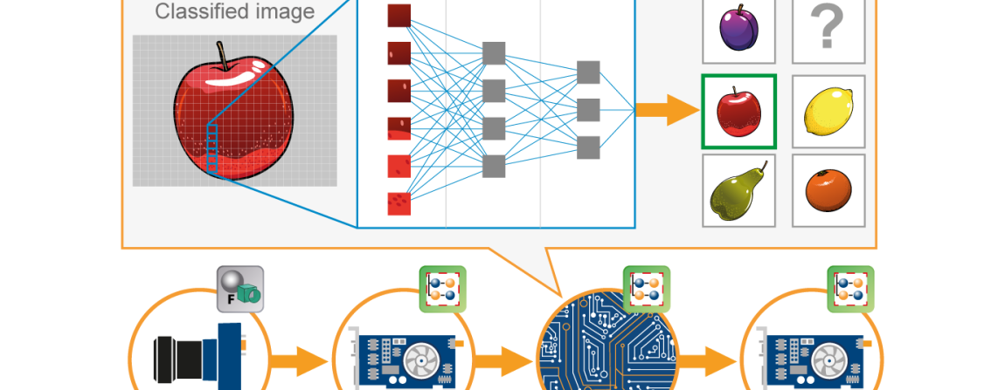
A convolutional neural network(CNN) is a type of Artificial Neural Network(ANN) used in image recognition and processing which is specially designed for processing data(pixels).

Slide 5
PREPARATION OF DATA-
Transforming pixel values from their original range of 0-255 to a normalized range of 0-1.
This ensures all values fall within a similar range, enhancing the training process for our neural network.

Slide 6
Building the CNN
Preprcoress the images that we downloaded and preprocessed and normalized to optimize model training.
Define the cnn architecture (
Choosing the function( reLU and sigmoid)
Define a loss function( using adam optimizer)
Train the dataset using an optimizer(Adam Optimizer)
Plot the dataset using mtplotlib
Evaluate and test the model
Save the model

Slide 7
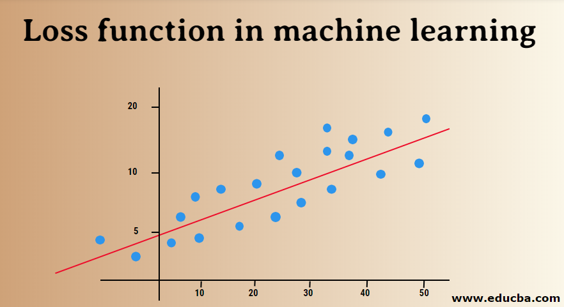
Training the Model
Data Split: We spit data into training and testing to prevent overfitting
Epochs: Each epoch represents one complete loop throught the entire dataset while traing dataset also we train it on multiple echos to get the result effectively ( 20 in our case)
Loss Function: Is a method that helps us to evaluate how well the the machine learning task is running
Optimizer: The "Adam" optimizer help us to minimise the loss function during the training of neural network

Slide 8
REFINING THE MODEL-MONITORING PROGRESS AND EVALUATION :
In order to evaluate we are gonna import some key metrics Precision, Recall, BinaryAccuracy and then we gonna test them out we gonna loop them and then run them to calculate accuracy.
We are gonna grab a random image that we didn’t loop in the sample and our model never seen it eg . (I used a happy image) happy person and after applying image.cv2 and resizing it we gonna run it.

Slide 9
RESULT OF THE MODEL
Result Prediction
Output Layer: The final layer of a CNN used for classification often has as many neurons as there are classes in the dataset. For example, if you're classifying images into 10 categories, the output layer will have 10 neurons.
Softmax Function: This function is commonly used in the output layer for multi-class classification. It converts the raw output scores (logits) into probabilities that sum to 100%. The neuron with the highest probability indicates the predicted class.
Confidence Score
Confidence Score: The confidence score, or probability, represents the model's certainty about a particular prediction. It is the value from the softmax function for the predicted class. A higher confidence score indicates greater certainty in the prediction.
Interpretation: A model might predict an image as a “HAPPY" with a confidence score of 0.85. This means the model is 85% confident that the image belongs to the “HAPPY" category. However, this score does not reflect the absolute accuracy of the prediction but rather the model's internal assessment based on the learned features.

Slide 10
CONCLUSION
In conclusion, image classification using CNN for image classification has revolutionized the field of computer vision, enabling accurate recognition of objects within images. With its ability to automatically learn and extract complex features, CNNs have become a powerful tool for various applications.

